Slide 1
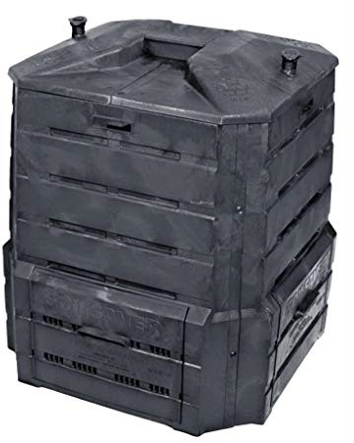
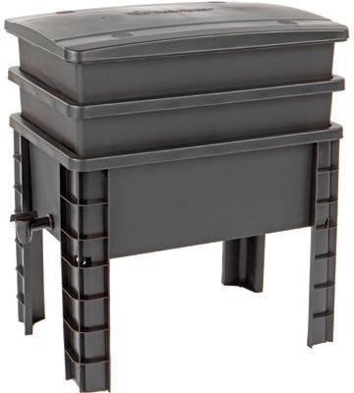
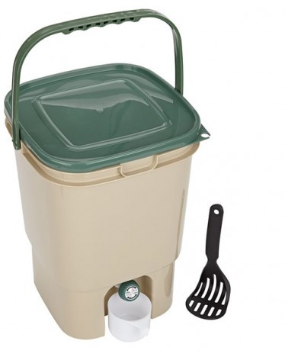

INTRODUCTION TO COMPOSTING
BROUGHT TO YOU BY THE CITY OF GLENDALE
BACKYARD COMPOSTING
WORM COMPOSTING
VERMICOMPOSTING
BOKASHI
/ https://glendalerecycles.com / (818) 548-3916 / recycle@glendaleca.gov

Slide 2
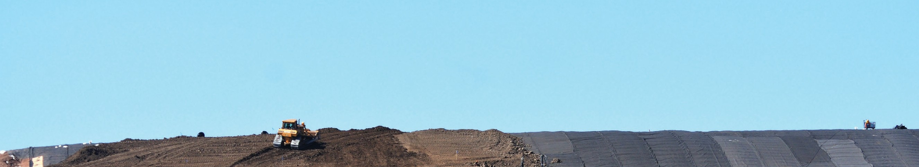



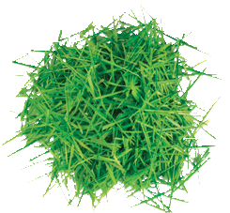
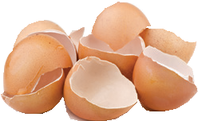
QUESTION
What Happens When Organics Decompose in the Landfill?
GREENHOUSE EFFECT
CARBON DIOXIDE
CO2
DECOMPOSING ORGANICS RELEASE
METHANE
CH4
LANDFILL SITE
Contains decaying organic waste from farms, kitchens, gardens, restaurants, markets
LANDFILL LINER
GROUND WATER

Slide 3


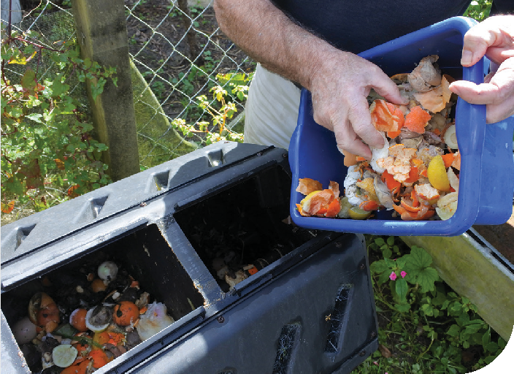
FOOD WASTE REDUCTION
SOURCE REDUCTION
Prevent food waste by serving smaller food portions and purchasing only what you need. Organize your refrigerator for optimal food storage.
EDIBLE FOOD RESCUE
Donate edible food to rescue organizations or share with neighbors. Extra food can also be used to feed animals such as backyard chickens
or livestock.
HOME COMPOSTING
Begin backyard or worm composting to reduce food waste, avoid garbage
collection and transportation costs.
** The City of Glendale offers worm bins and backyard compost bins for sale to residents.
Contact: recycle@glendaleca.gov

Slide 4

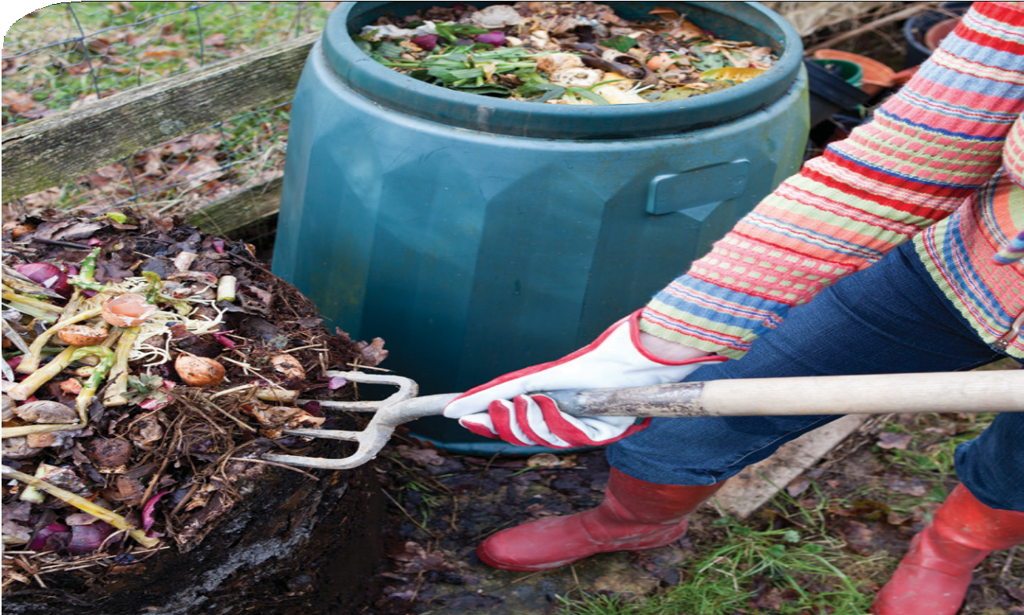


SOLUTION
Feed your landscape, not the landfill! Compost today...
Reduce waste disposal Reduce greenhouse gases Reduce water use
Promote greener, healthier yards and gardens
Improve soil structure
Increase nutritional value of edible gardens

Slide 5
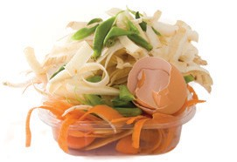

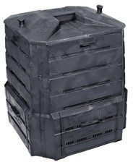
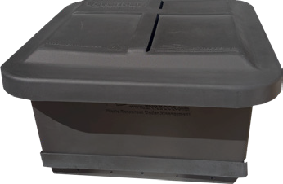
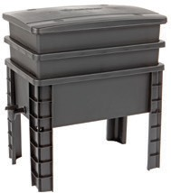
OPTIONS
Is BIN or WORM composting right for you?
How much waste? What type of waste? What type of space?
Primarily kitchen scraps from fruits and vegetables, garden trimmings
Lots of yard waste (mowing, pruning, leaves, kitchen scraps also OK)
Small space (kitchen, patio, small yard)
Large yard with lots of planted space
Vermicomposting
Backyard options

Slide 6
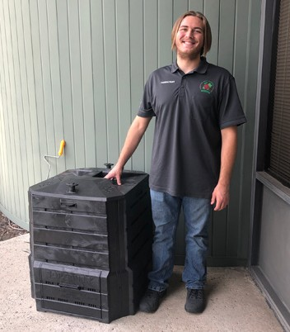
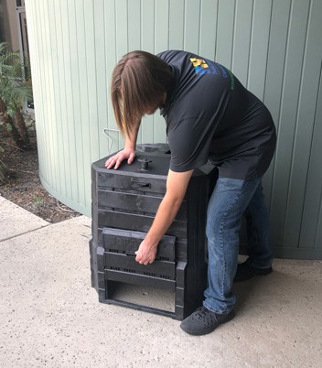
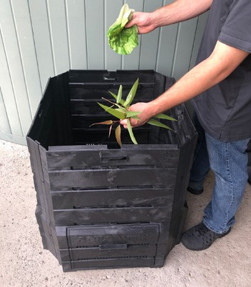
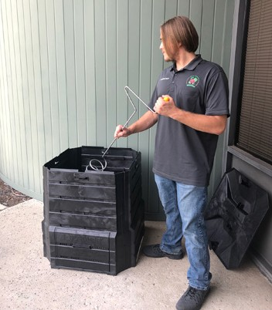
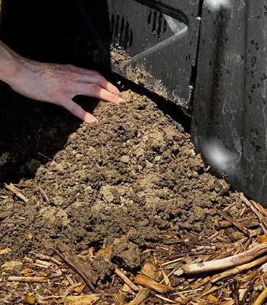
BACKYARD COMPOSTING
Get to Know Your Bin
Harvest compost from bottom door
Easily access finished compost
Here is your new bin
Load from the top
Stir every week

Slide 7
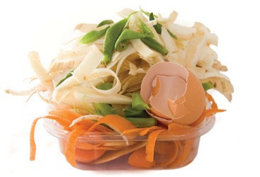
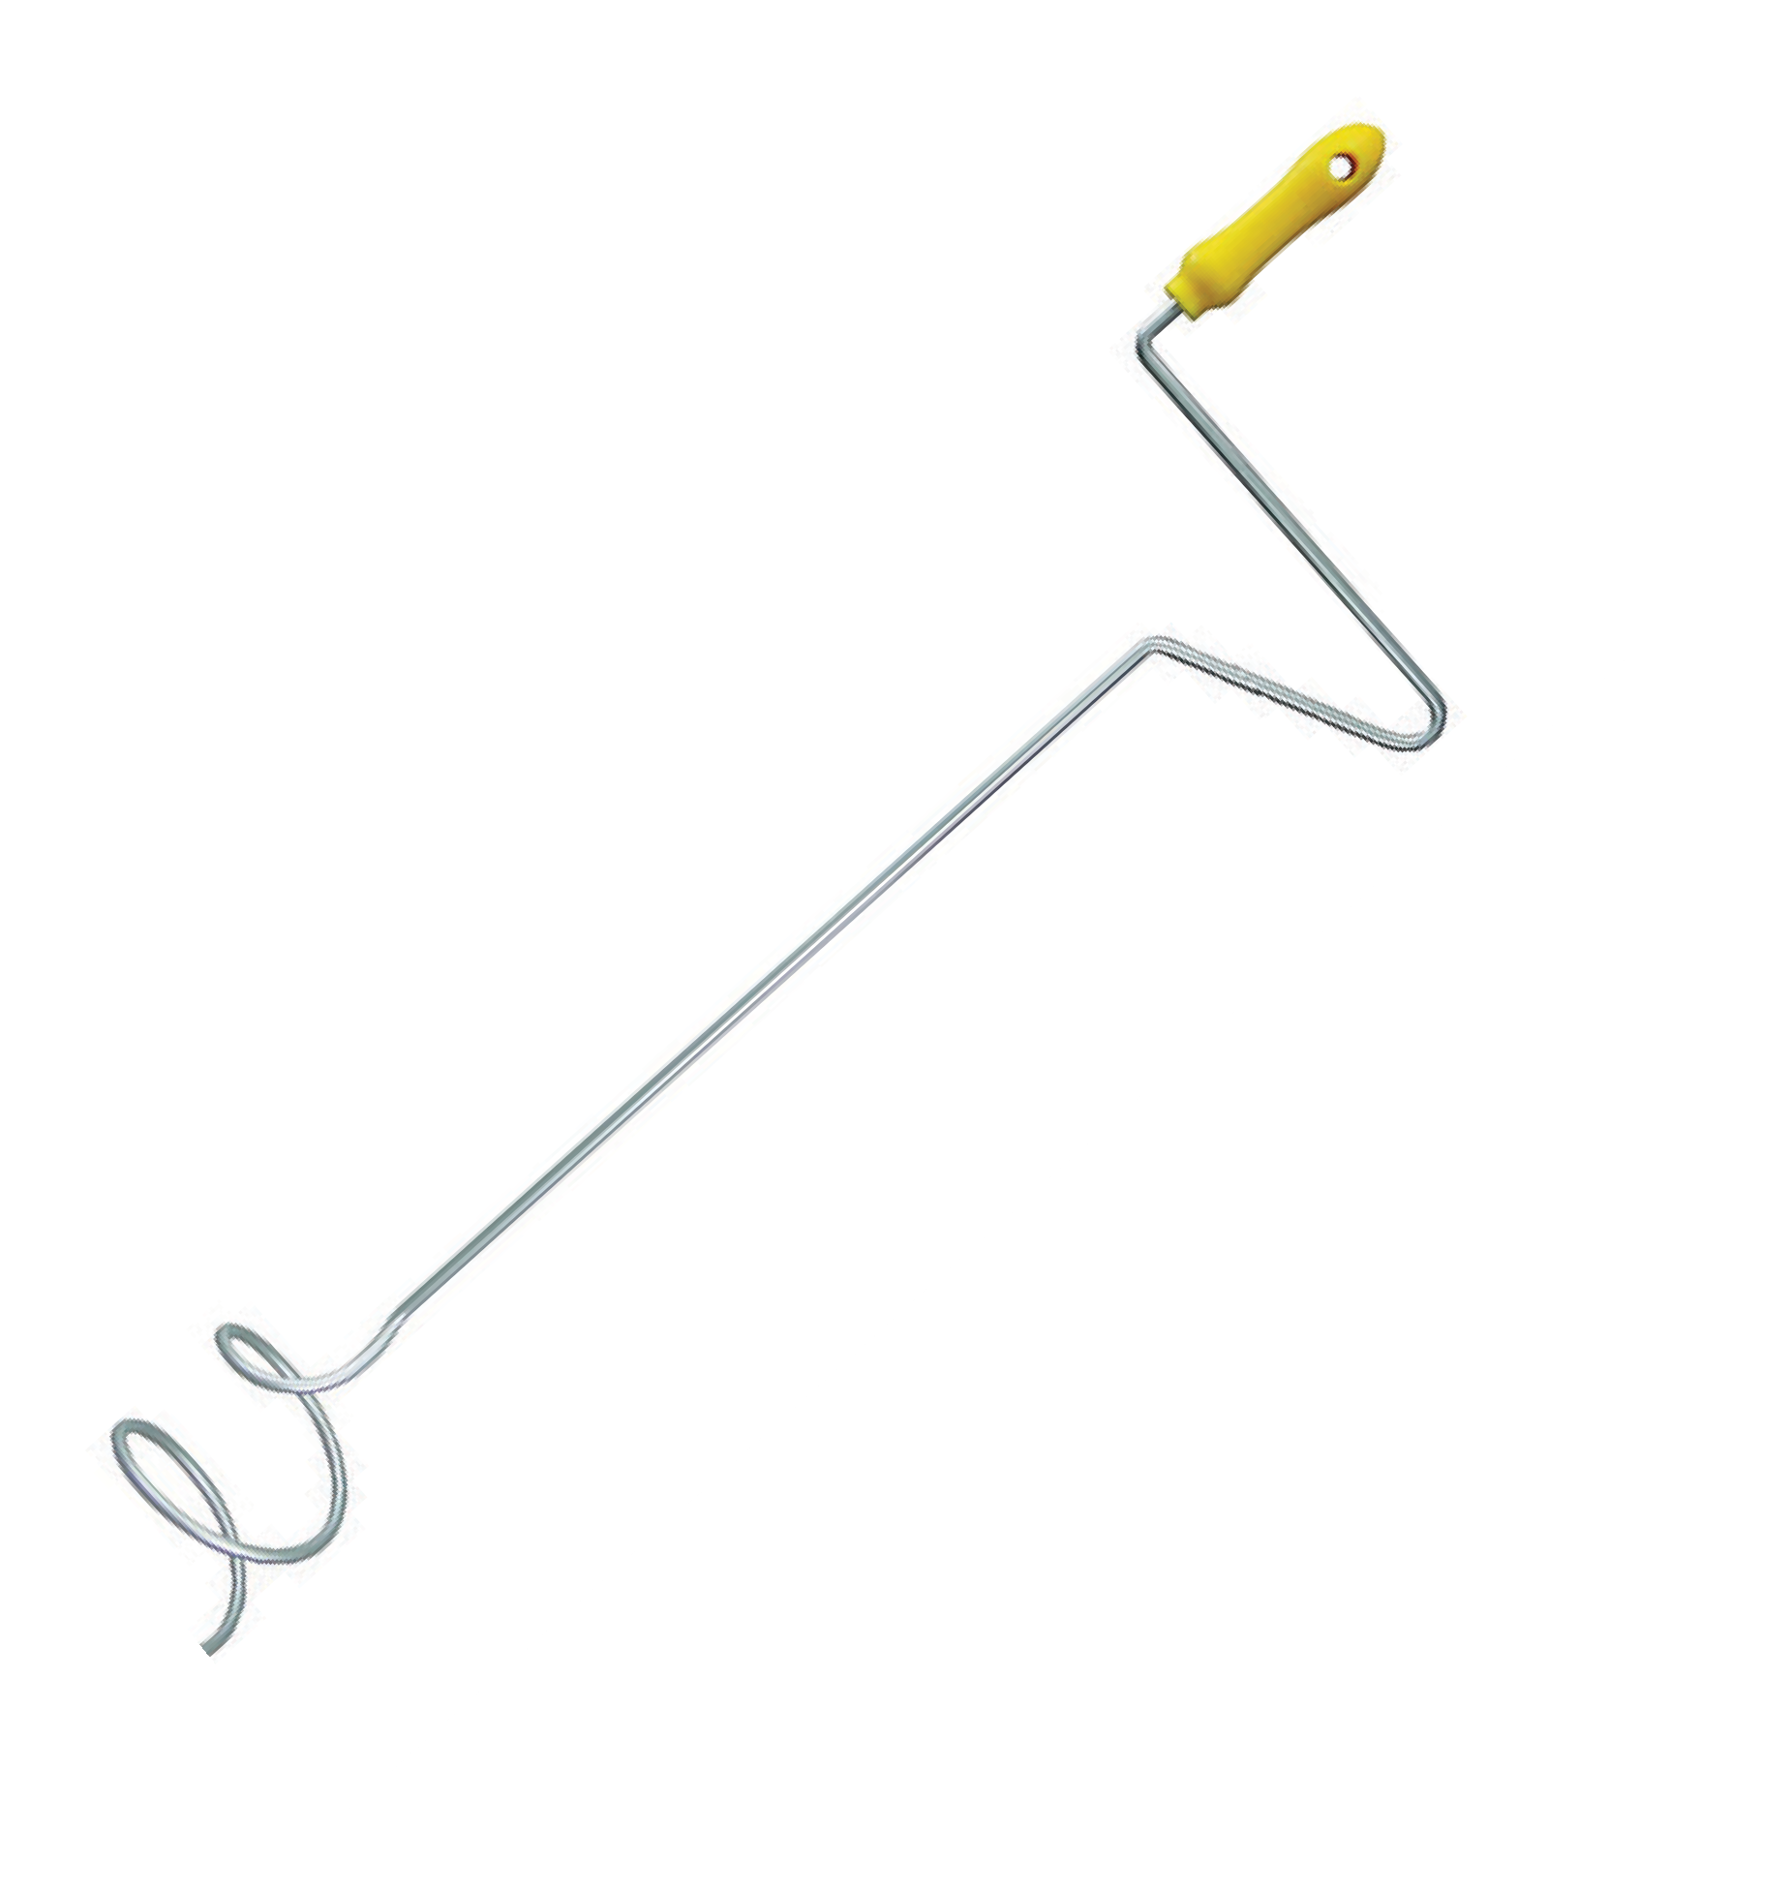
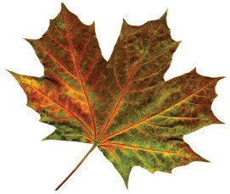
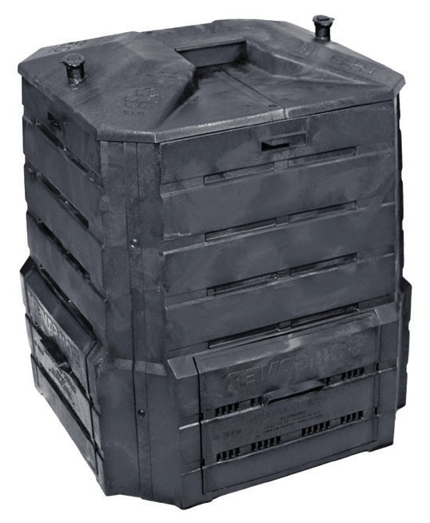
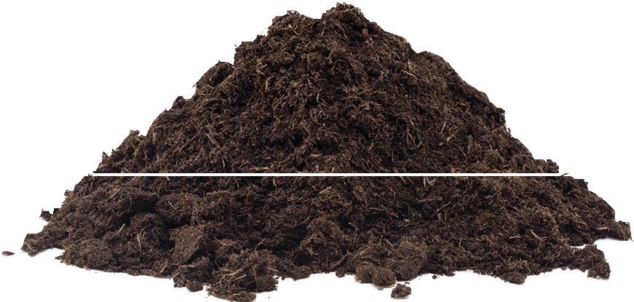
BACKYARD COMPOSTING
How To
INPUT
50% GREEN MATERIALS
+
50% BROWN MATERIALS
(equal by volume) Smaller particles decomposes faster
WATER H2O & AIR O2
Turn and water bin every 7-10 days
6 TO 9 MONTHS
Use when it’s brown, crumbly and smells like soil
Remove from bottom of bin
Add new materials as you go

Slide 8
BACKYARD COMPOSTING
Compost Process
INPUT
NITROGEN RICH GREEN MATERIALS
Green grass, food scraps, fresh plant materials
CARBON RICH BROWN MATERIALS
Dried leaves, straw/hay, woody materials, newspaper/cardboard
WATER H2O MACRO-ORGANISMS
Worms, insects, micro-anthropods
AIR O2
MICRO-ORGANISMS
Bacteria, fungus, nematodes, protazoa
WATER VAPOR
GAS CO2
HEAT
OUTPUT

Slide 9
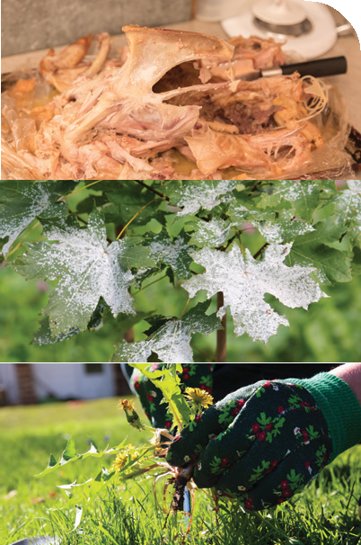


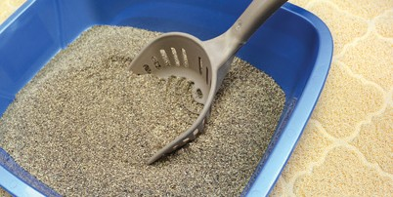
BACKYARD COMPOSTING
Materials to Avoid (stop problems before they start)
Meat, grease, bones or meat by-products
Dairy products
NO
Diseased or infected plants
Glossy or treated paper
NO
Invasive weeds
Seeds
NO
Pesticide-treated clippings
Pet litter or feces
NO

Slide 10
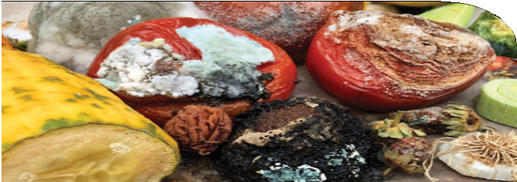
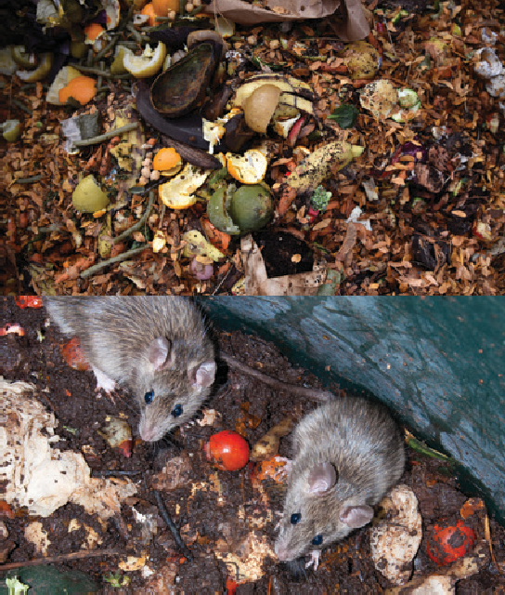

BACKYARD COMPOSTING
Compost Troubleshooting Tips
Fruit flies or mold in kitchen container
Bin not getting hot (under 130°)
130°
Bin getting too hot (above 150°)
Slow composting
150°
Odors from bin
Vermin in bin

Slide 11
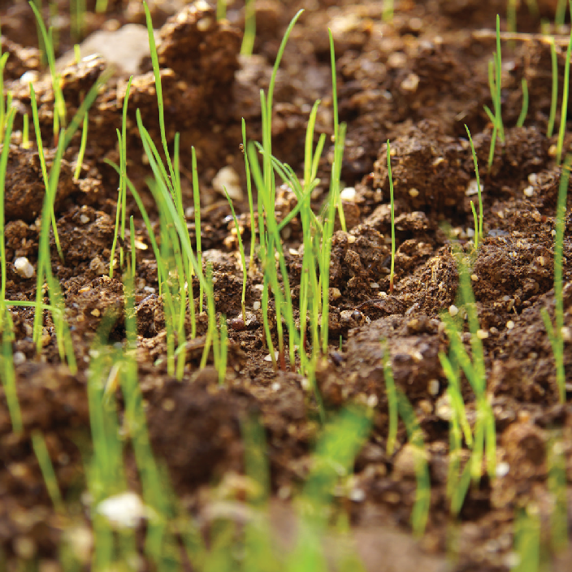
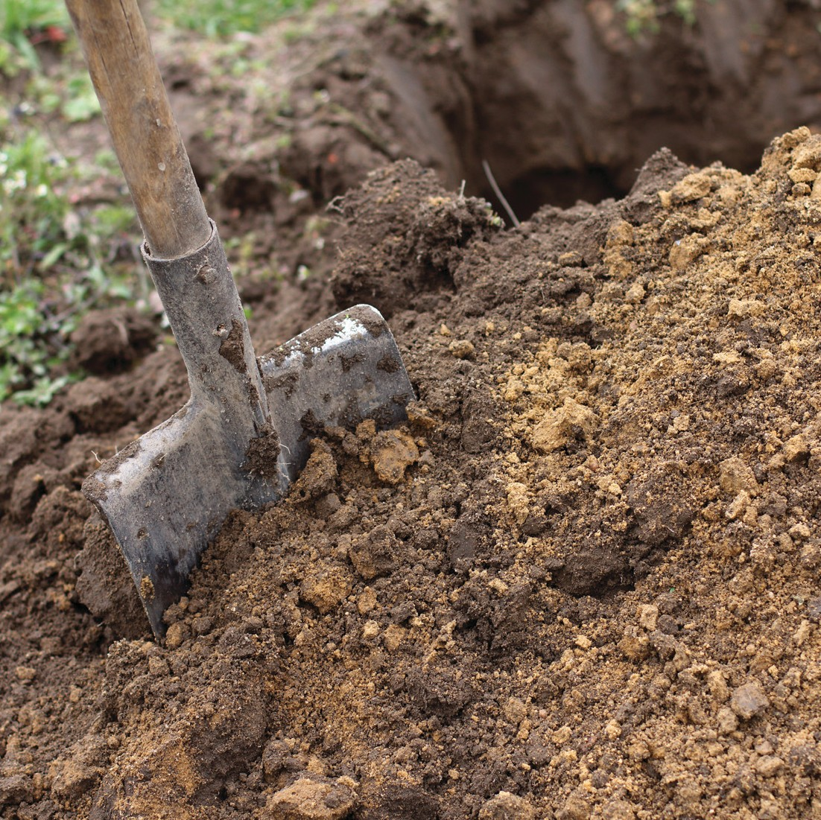
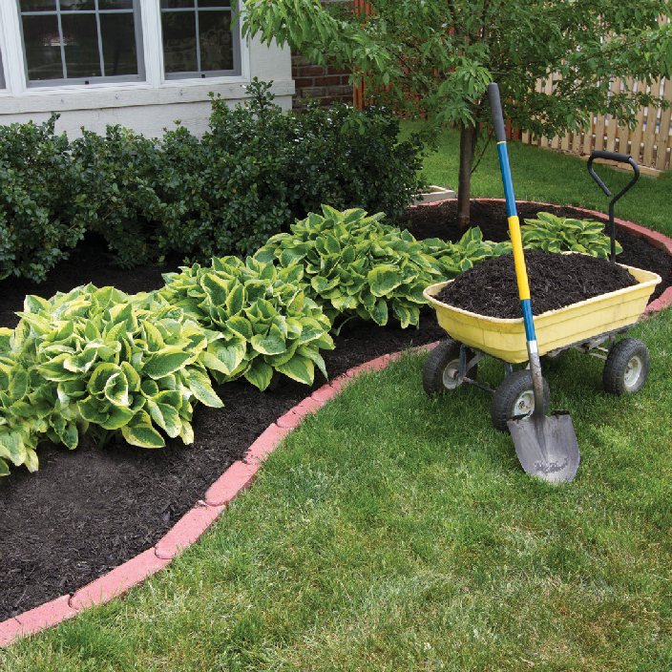
RESULTS
Using Your Compost
SPRINKLE LIGHTLY OVER GRASS
ADD TO SOIL MIX WHEN PLANTING
ADD TO SOIL AROUND ESTABLISHED PLANTS

Slide 12


WORM COMPOSTING
Why
No smell if managed properly
A convenient way to recycle kitchen food scraps
Worm castings improve soil and contain valuable nutrients and beneficial microorganisms
Reduces waste and conserves natural resources
Compost in less than 2 months
Won’t “burn” plants like chemical fertilizers can
5 - 11 times the nitrogen, potassium and phosphorus of typical soil
Compost bins are small, easy to use and work indoors or out

Slide 13
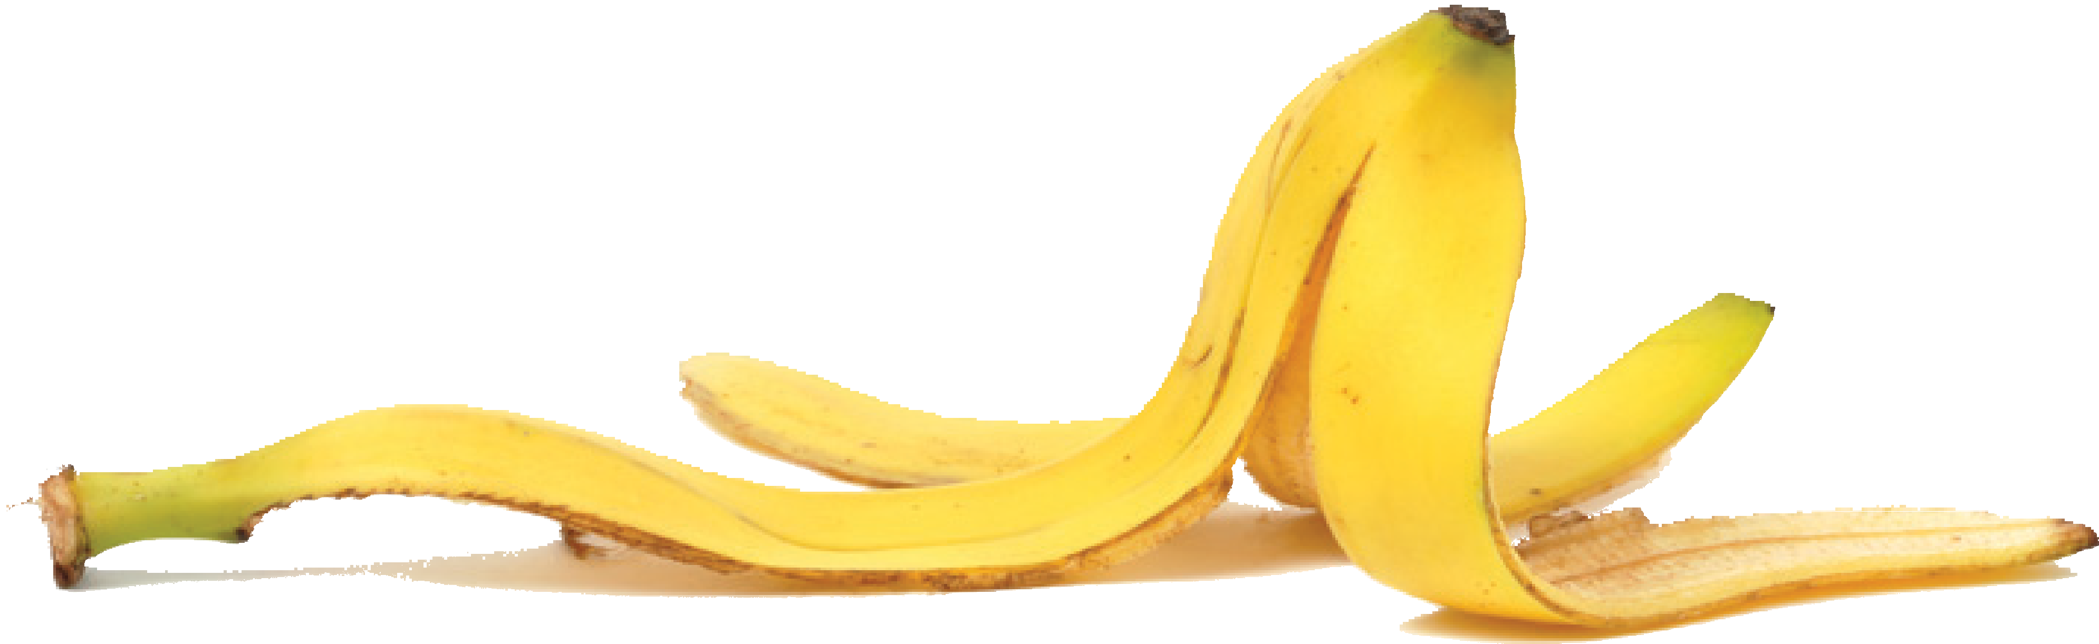

WORM COMPOSTING
How To
Use a box or bin
Add bedding of newsprint or coconut coir
Feed your worms regularly and add a second tray when first is full.
Bury food scraps into bedding Keep out of direct sun
Keep bedding moist
Add egg shells (maintains proper pH)
GOOD for worms:
Fruit and vegetable scraps
Coffee grounds and filters
Tea bags and leaves
Shredded paper
BAD for worms:
Meat and dairy
Animal by-products
Citrus rinds
Fats, oils and grease
Processed, salty or canned foods
Animal manure

Slide 14
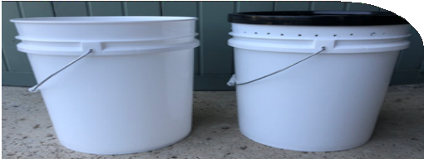
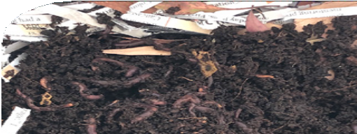
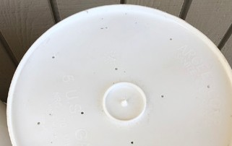
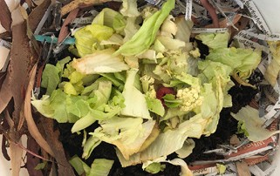
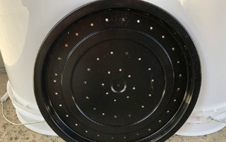
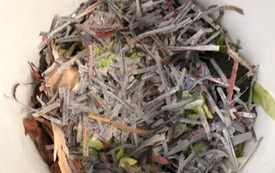
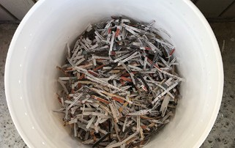
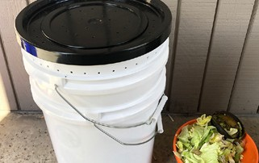
WORM COMPOSTING
DIY Worm Bin
5 Add ½ pound of worms
1
Purchase two food grade
5-gallon buckets and one lid.
6 Add food scraps
2 Drill 1/4” drain holes in the bottom of one bucket
3 Drill small 1/8” air holes along top edge of the same bucket and in the lid
4 Make bedding by placing shredded newspaper and dried leaves approximately 6” high in bucket and mist with water
7 Cover with bedding
8 Mist daily if dry and feed as needed

Slide 15
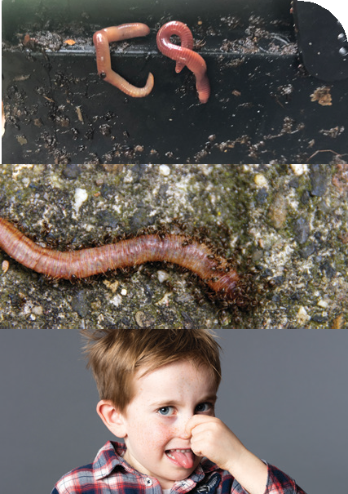
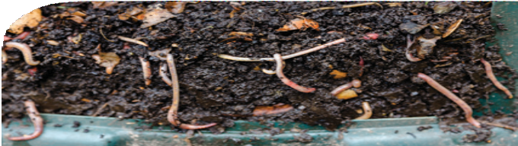
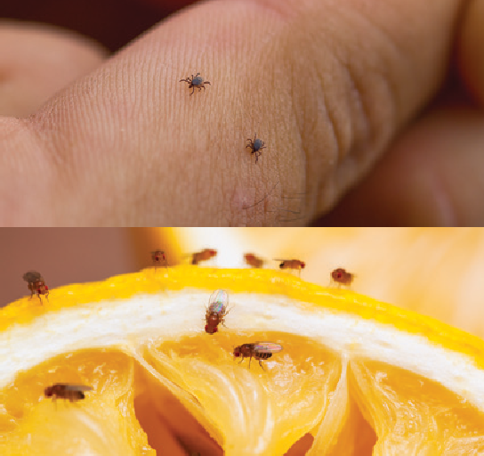
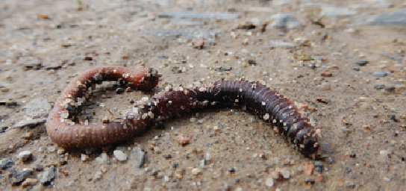
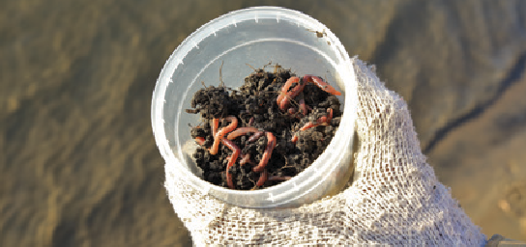
WORM COMPOSTING
Troubleshooting Tips (stop problems before they start)
Clumps of worms in corners or on lid
Bedding too moist
Ants
Mites
Offensive odors and/or leachate smells
Fruit/vinegar flies
Worm lifespan/dying
Need more worms

Slide 16

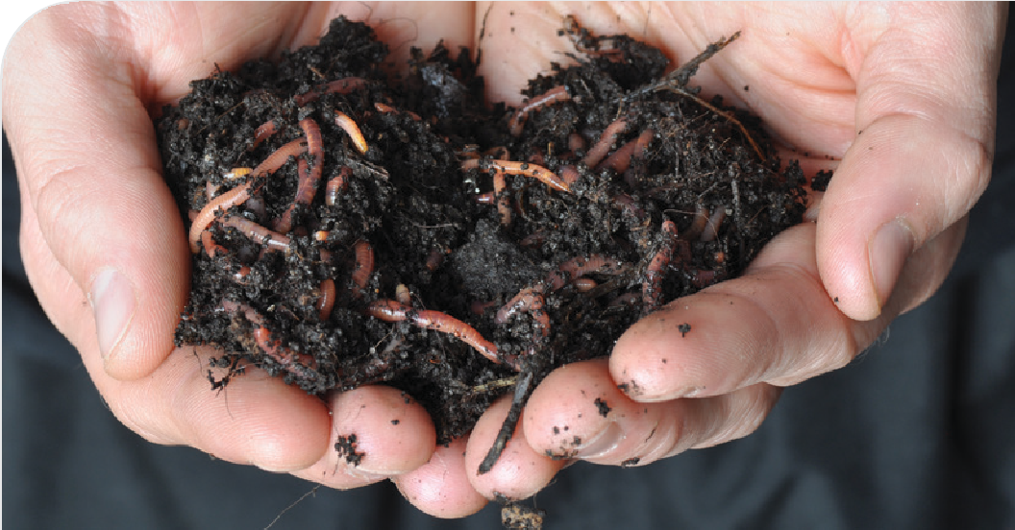
WORM COMPOSTING
Harvesting Worm Compost
Feed one end, side or tray for two weeks
Remove worm compost from other end, side or tray
Put worms back in bin if any remain with harvested compost
Mix worm compost into soil
Empty worm leachate weekly or as needed

Slide 17
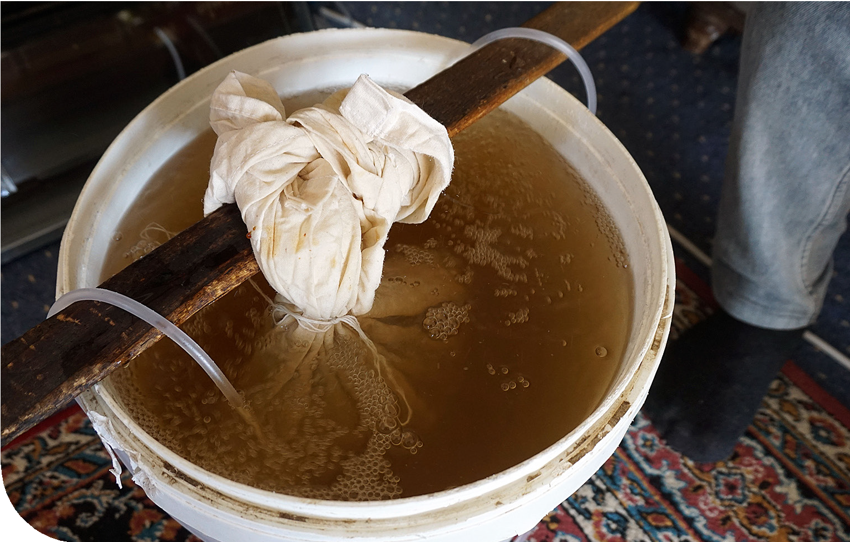
WORM COMPOSTING
Worm Tea Vs. Worm Leachate
Worm leachate is the liquid byproduct of worm composting and may contain harmful bacteria.
Worm tea is a liquid fertilizer that can be made by mixing or
“steeping” finished worm castings in water. Various recipes and methods can be found online.
For more information on worm leachate versus worm tea, visit:
https://www.solanacenter.org/resources/compost-it-yourself/compost-tea-worm-tea-leachate

Slide 18
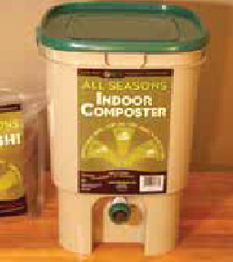
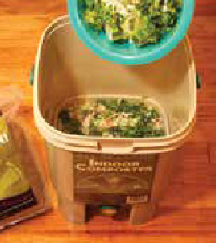
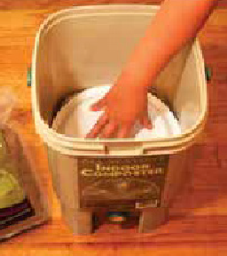
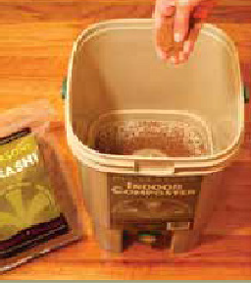
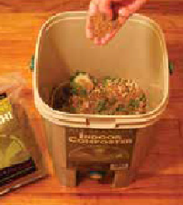





BOKASHI COMPOSTING
1. Start with Bokashi composter and bokashi mix.
4. Add food scraps in layers (up to three at at time).
7. Cover and press down contents with a plastic bag or plate and leave in place until next use.
2. Dust bottom of composter with mix, being careful not to block small holes.
5. Dust each layer with bokashi mix
(use more for meat, bones and dairy).
8. Close lid tightly. Repeat steps 3 through 7 whenever new food scraps are ready and until composter is full.
3. Chop food scraps (including meat and dairy) into small pieces before adding.
6. Use spatula or spoon to mix layers together then sprinkle more mix on top.
9. Drain liquid (tea) with spigot every 2 to 3 days or as needed. Dilute to one tablespoon tea to one gallon of water and use to water plants.
10. When bucket is full, bury fermented contents in the garden to finish decomposition process. This can take between two weeks and one month, depending on temperature and weather.

Slide 19
BOKASHI COMPOSTING
Can fermented bokashi be added to worm bin?
How do I get rid of a foul odor from my bokashi bin?
Should there be mold in the bokashi bin?
Yes, in small amounts at a time. If too much is added at once, it can make the contents too acidic, so use in moderation.
It is normal for the contents of your bokashi bin to have a slight sour, pickle-like odor. But
if smell is foul, make
sure the lid is airtight and try adding more bokashi mix. If that doesn’t correct the issue, you should empty the contents and start over.
White mold is fine. Black, green or red mold is a sign that the bin is contaminated
— contents should be
emptied and the bin should be started over. Make sure it is tightly sealed and enough bokashi mix is being added in the next batch.

Slide 20

COMPOSTING RESOURCES
Online Resources
SmartGardening.com CleanLA.com LAgardencouncil.org LAcompost.org Composting.ces.ncsu.edu UCANR.edu glendaleca.gov
Email: recycle@glendaleca.gov

