Slide 1
2021 Glendale CoC System Performance
Presented by: Richmond Amoah | HMIS System Admin

Slide 2
Agenda
2021 HMIS Program Performance
HIC/PIT
HMIS Data Quality & Data Corrections in Preparation for System Performance Measures, HIC, & LSA

Slide 3
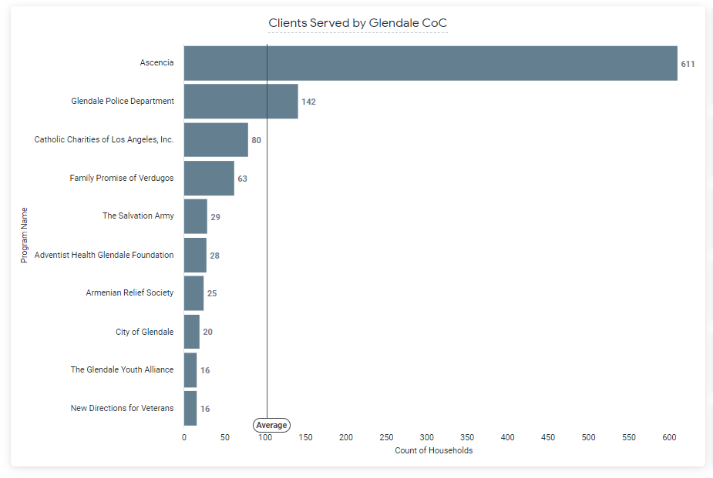
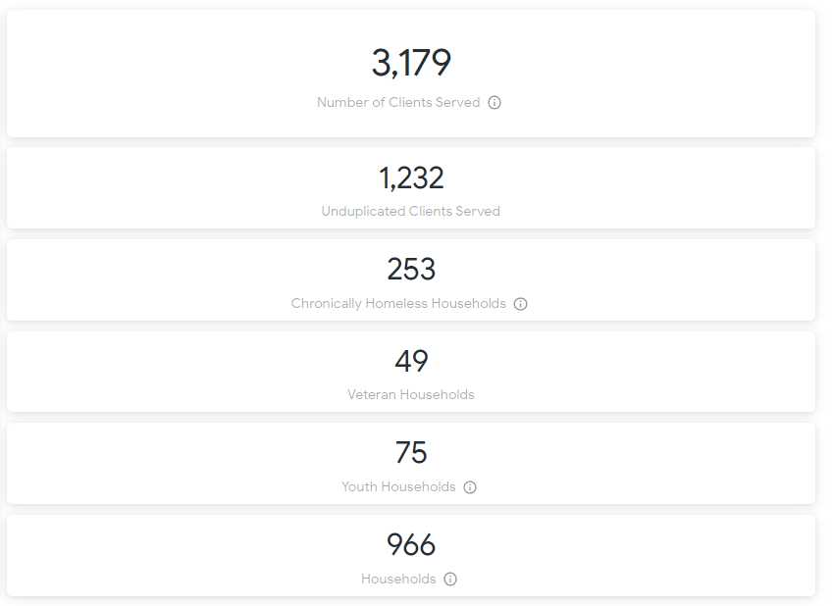
2021 Glendale CoC Program Performance

Slide 4
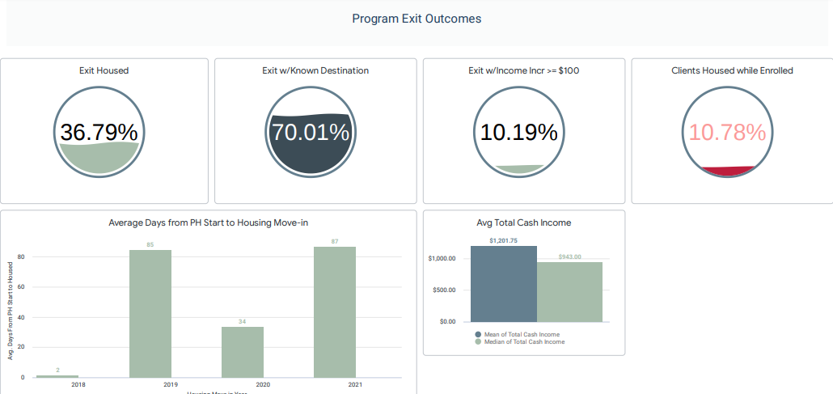
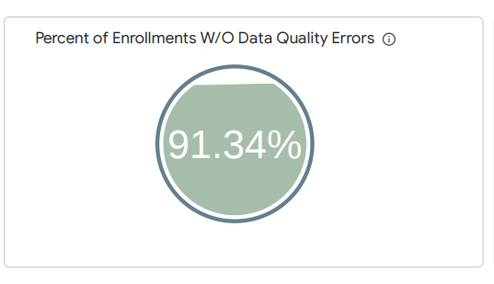
2021 Glendale CoC Program Performance

Slide 5
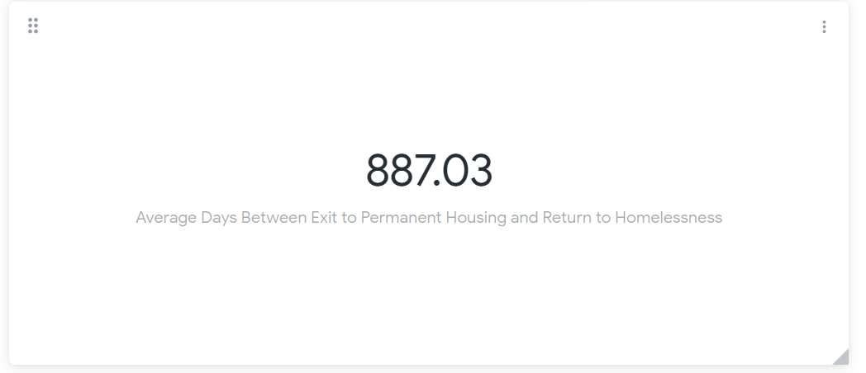
2021 Glendale CoC Program Performance

Slide 6
HIC (Sheltered Count)
The HIC is conducted annually and reports on shelter and on the following housing projects (ES, SH, TH, RRH, PSH), including non-participating HMIS programs (e.g. DV programs) that fall under the same project types . **Official Glendale forms should be completed by Agency Admins and submitted by 28th February 2022
The HIC includes:
Bed/unit capacity
Federal funding source
Number & Type of households and clients served
Target Population
Housing Type
Location (geocode and address)
HMIS Data Quality
Utilization rate based on clients in shelter/housing during one night in February (point-in-time count)
Glendale EHV Assessment
4.20
4.12
Coordinated
Situation
Entry Event
Coordinated Entry
4.19
Coordinated Entry Assessment
Refer Client to EHV Program

Slide 7
HMIS Data Quality for HIC, LSA, SPM
Demographic data: birth dates reflect minor/adult status correctly, all other demographics are as complete as possible.
Enrollment/exit data: dates, head of household, group enrollments are correct.
Move-in Date (Permanent Housing projects only): ensure the residential move-in date reflects the date that the client started residing in permanent housing
Overlapping Enrollments: ES, TH, SH Programs
Data Corrections:
Communicate with HMIS@GlendaleCA.GOV
to correct any data, you can’t fix yourself
Glendale EHV Assessment
4.20
4.12
Coordinated
Situation
Entry Event
Coordinated Entry
4.19
Coordinated Entry Assessment
Refer Client to EHV Program

